Slide 1
Digital Marketing Overview
Anton Koekemoer

Slide 2
Agenda
Digital marketing overview
1
What is digital marketing?
2
Why are people going online?
3
Benefits of digital marketing
4
What does digital marketing consist of?
5
How digital marketing evolved
6
Search engine optimization (SEO)
7
Pay per click (PPC)
8
Social media Marketing (SMM)
9
Digital marketing measurement

Slide 3
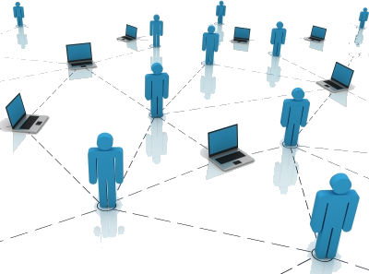
Digital Marketing Overview
Introduction
What is digital marketing?
“Digital marketing” is the process of building and maintaining customer relationships through online activities to facilitate the exchange of ideas, products, and services that satisfy the goals of both parties.
Plain English: Getting found online

Slide 4
Digital Marketing Overview
Why are people going online?

Slide 5
Digital Marketing Overview
Why are people going online?
For information on a new product, service or location
If they have a question
If they are looking for help
If they want more information on certain individuals or organizations
Meeting attendants
Business contacts
General information (maybe about you…)
New employees
Available jobs
Etc.
With the constant growth of the web, and more people getting connected every day, digital marketing has become a necessity for many organizations. This also includes small businesses that wants to trade online and make a name for themselves on the web.
The web is crowded with information. If you have a website, can these people reach you that are searching the web for answers?

Slide 6
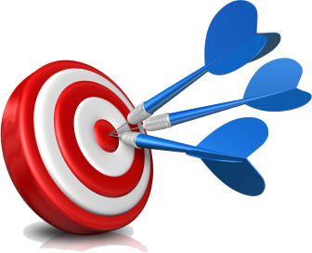
Digital Marketing Overview
There are many benefits of digital marketing
Over traditional marketing *
Puts the consumer in control
Provides convenience
Increases satisfaction
Drives brand loyalty
Reduces the selling cycle
Reduces the cost of sales
Builds your brand
Provides targeted results
It is measurable *
Cost effective *

Slide 7
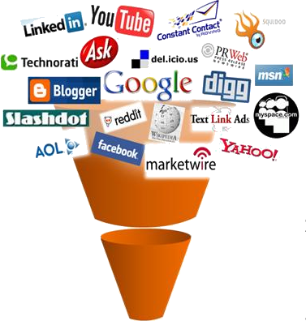
Digital Marketing Overview
What does digital marketing consist of?
Key components
Website design (user experience)
Search engine optimization (SEO) *
Pay per click (PPC) *
Social media marketing (SMM) *
Email marketing
Display advertising (banner ads)
Affiliate marketing
Content marketing
Online reputation management (ORM)

Slide 8
Digital Marketing Overview
Digital marketing objectives
One way to make sure you are found on the web is with an optimized digital marketing strategy. Most digital marketing strategies and campaigns have following 5 objectives.
Reaching the right audience
To engage with your audience
To motivate your audience to take action
Efficient spending on your campaign
Return on investment (ROI)
Digital marketing goal
Digital marketing is about generating sales and/or capturing leads from customers that are searching on the Internet for answers.

Slide 9
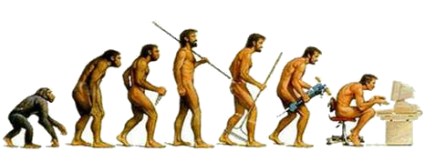
Digital Marketing Overview
How digital marketing evolved over the years
Back in the day, it was all about search engine optimization – (organic search)
Build a website
Apply the art of on and off page SEO to your website, you build links, you build more links, and you build even more backlinks, focus on the meta-tags, content, etc.
You hope it shows up in Google someday
You hope it displays on the results with the right keywords (what people are typing in when they search)
It was like fishing and hoping you will get a catch.
With SEO, PPC was born – (paid search)
Google’s Adwords (3 line ads that show up on the right/top of search engine results)
Microsoft’s Adcenter
Yahoo’s search marketing (Overture)
Build ads around keywords and pay for everyone that clicks the ad and visits your site

Slide 10
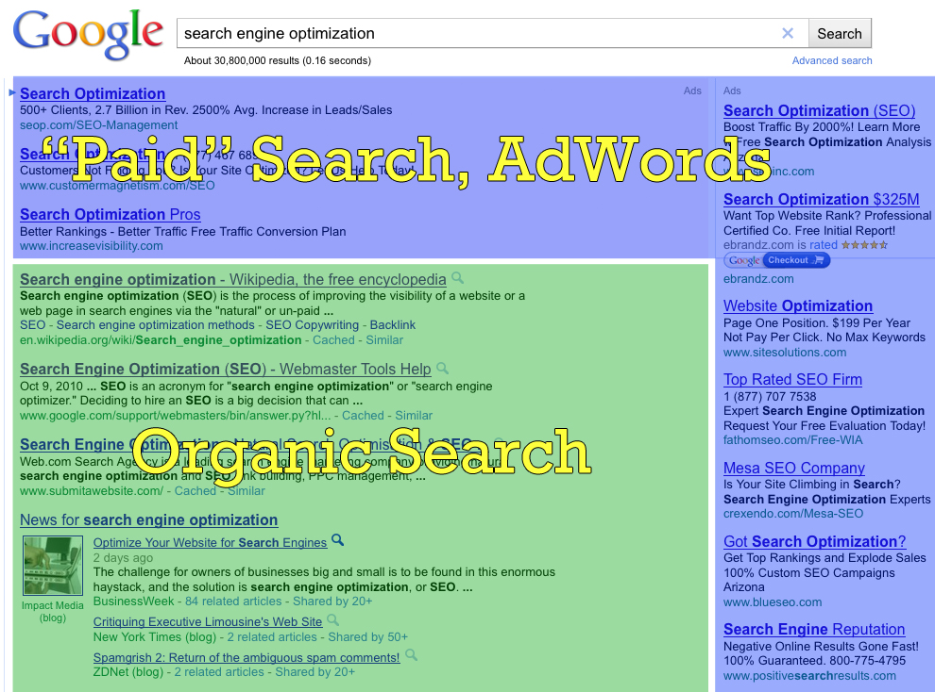

Slide 11
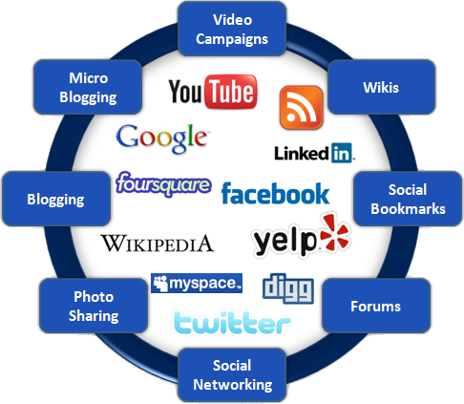
Digital Marketing Overview
The future of the web is social media (Web 2.0)

Slide 12
Digital Marketing Overview
Search engine optimization (SEO)

Slide 13
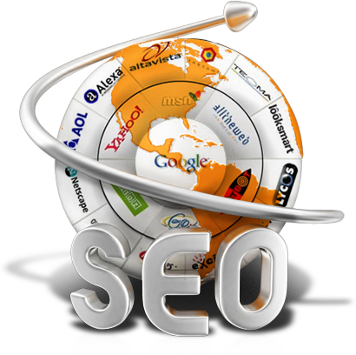
Digital Marketing Overview
What is search engine optimization (SEO)?
SEO definition
Search engine optimization (SEO) is the process of getting traffic from the “free,” “organic,” “editorial” or “natural” listings on search engines.
All major search engines such as Google, Yahoo and Bing have such results, where web pages and other content such as videos or local listings are shown and ranked based on what the search engine considers most relevant to users. Payment isn’t involved, as it is with paid search ads.

Slide 14
Digital Marketing Overview
Advantages of search engine optimization (SEO)
Your website will be found
Improve your competitive edge
Expand your customer base and target audience
Cost effective
Long term standings
Free traffic
Targeted traffic
Higher sales (ROI)
Global reach
All the results can be measured
Better conversion (sales)
Pull marketing
Increased visibility
Your own 24 hour marketing team and shop front

Slide 15
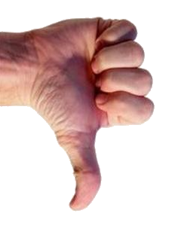
Digital Marketing Overview
Disadvantages of search engine optimization (SEO)
Often, websites are never “indexed” by the search engines
After sites are indexed, often they are not indexed for specific keyword(s)
Website owners have no idea which search terms would really be best to drive traffic
Fresh content is very important, but hard to keep up with
Domain age plays a role
It’s hard work and time consuming
No one really understands how Google works
If your competition is high, it gest more difficult
Takes a long time to see the best results
Gestation period is long *
On going process

Slide 16
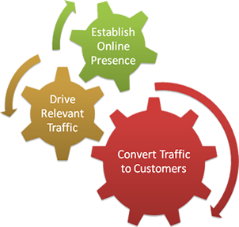
Digital Marketing Overview
Basic search engine optimization (SEO) strategy
Research, research, research, research, etc
Keyword research (what keywords are you going to target?)
Build a kick ass website (Ryan and co)
Make SEO friendly URL’s (anton-is-cool instead of anton.php?id=xyz)
Unique and relevant titles on every page
Write for users
Optimize content to include keywords (use selected keywords once every 100 words)
Create great unique content (content is king)
Use your keywords as anchor text when linking
Use alt text + title text in links
Name images to what they represent (add alt text + title text)
Build links intelligently (link smartly)
Create a sitemap (submit to Google and Bing webmasters html+XML)
Include website analytics (Google Analytics)

Slide 17
Digital Marketing Overview
Pay per click (PPC)

Slide 18
Digital Marketing Overview
What is pay per click (PPC)?
PPC definition
Pay per click (PPC) is a type of sponsored online advertising that is used on a wide range of websites, including search engines, where the advertiser only pays if a web user clicks on their ad. Hence the title, 'pay per click'.
Advertisers place bids on keywords or phrases that they think their target audience would type in a search field when they are looking for specific goods or services.

Slide 19
Digital Marketing Overview
Advantages of pay per click (PPC)
Very fast
Get targeted visitors within hours (sometimes minutes)
Provides a path for search engine optimization
Can yield highly profitable results
Great testing platform and can be highly targeted
Time of day
Geographic area
Keywords and phrases
Content network (Google)
Immediate feedback
No guestimation
Easy implementation
Flexible

Slide 20
Digital Marketing Overview
Disadvantages of pay per click (PPC)
Missing bulk of the traffic (focusing only on selected keywords)
No guarantees
Heavy competition
Less trusted
Expensive
Complicated
Click fraud
You pay regardless to any sales
Bidding war
Competitive keywords demands higher bids
Restricted to text and image ads
Traffic stops when you stop paying

Slide 21
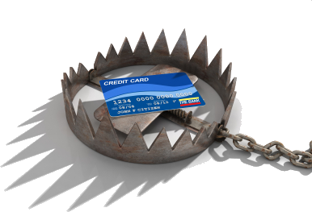
Digital Marketing Overview
Basic pay per click (PPC) strategy
Research, research, research, research, etc
Keyword research (what keywords are you going to target?)
Choose which demographic you are going to target
Location, location, location
Make an offer they can’t refuse in your PPC ad (SEO Copywriting)
You can go mobile
Be dynamic
Utilize long tail keywords
Timing is everything
Create dedicated landing pages with CTA’s
A home page is not a landing page
Research all the keyword generators
Review your Google quality score
Has to be 7/10 to be displayed

Slide 22
Digital Marketing Overview
Social media marketing (SMM)

Slide 23
Digital Marketing Overview
What is Social media marketing (SMM)?

Slide 24
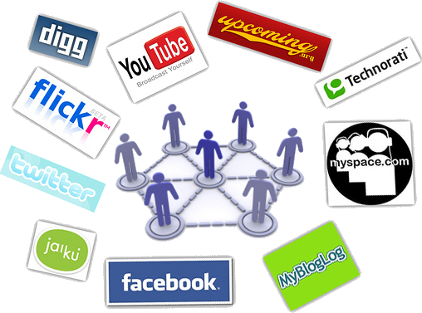
Digital Marketing Overview
What is Social media marketing (SMM)?
Social media marketing definition
Social media is a medium and the medium is only a vehicle that amplifies social behaviour.
The medium is an instrument on communication, like a newspaper or a radio, so social media would be a social instrument of communication.

Slide 25
Digital Marketing Overview
What is Social media marketing (SMM)?

Slide 26
Digital Marketing Overview
Advantages of social media marketing (SMM)
Better targeting
High return on investment (ROI)
Does not require specialization or vast technical skills
Increased visibility
Targeted traffic
Content promotion
Helps with PR
Fun way to do business
Ability to go viral
Expedites online brand development
Cost effective (only time and effort)
Market research (what are your customers talking about?)
Create relationships with your customers
Campaigns has the ability to drive huge amounts of traffic
Supports traditional and other digital marketing campaigns

Slide 27
Digital Marketing Overview
Disadvantages of social media marketing (SMM)
Wrong strategy can hurt your reputation
More time consuming than SEO and PPC
Interaction is needed at each location point
No short term ROI
No clear definition of social media ROI
Risk of negative comments
ORM processes are needed for big social media marketing campaigns.
Negative influence on worker productivity
Everything is public
Commit resources
Ineffective use = brand credibility loss

Slide 28
Digital Marketing Overview
Basic social media marketing (SMM) strategy
Social media (Web 2.0) technologies (Twitter, Facebook, YouTube, Pinterest, LinkedIn) consistenly changes all the time and your SMM strategy should NEVER start with the technology part of it. The POST method is an excellent starting point for any SMM campaign.
The POST method stands for “People, Objectives, Strategy, Technology”, and this method helps to address the burning question of “should my company have a social media marketing strategy?”
POST Method
People: Do you know who your target audience is? What are their demographics and interests?
Objectives: What do you want to accomplish with your social media marketing campaign?
Strategy: How will things be different after you launch your social media marketing campaign?
Technology: What social media channels are you going to use?

Slide 29
Digital Marketing Overview
Digital marketing measurement

Slide 30
Digital Marketing Overview
Digital marketing measurement
Calculation
ROI (return on investment) = [(Payback - Investment)/Investment)]*100
Many tools and systems are available to calculate your ROI and to measure the effectiveness of your digital marketing campaign.
ROI tools
Google analytics
Google webmasters tools
Basic google search
Google adwords
Social media monitoring tools
Sentiment analysis tools

Slide 31
THANK YOU!
Twitter: @AntonRSA
Blog: http://www.antonkoekemoer.com

